Slide 1
InfoEdge Ventures
AI Hackath💡n2024
Hack the future - innovate AI

Slide 2
Predictive
Maintenance System for Manufacturing Equipment
Team Deatails :
a . Team Name : PECML BOY'S
b. Team Leader : ROHITKUMAAR V
c. Team Members :
- MADHANKUMAR M K A
- RISHIPANDIAN R

Slide 3

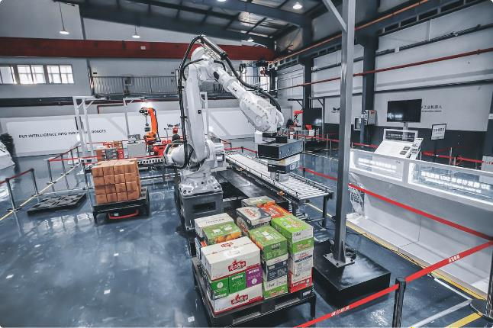
Importance of Predictive
Maintenance in Manufacturing Manufacturing
1
Cost Efficiency
2
Increased Equipment
Equipment Life
Predictive maintenance reduces unexpected downtime, saving costs.
Regular monitoring extends extends the lifespan of manufacturing assets.
3
Enhanced Safety
More reliable equipment leads to safer working conditions.

Slide 4
Key Components of a Predictive Maintenance System
Data Collection
Data Analysis
Actionable Insights
Involves gathering data from sensors and sensors and machinery.
Utilizes algorithms to interpret collected data.
Offers recommendations for maintenance actions based on data. data.

Slide 5

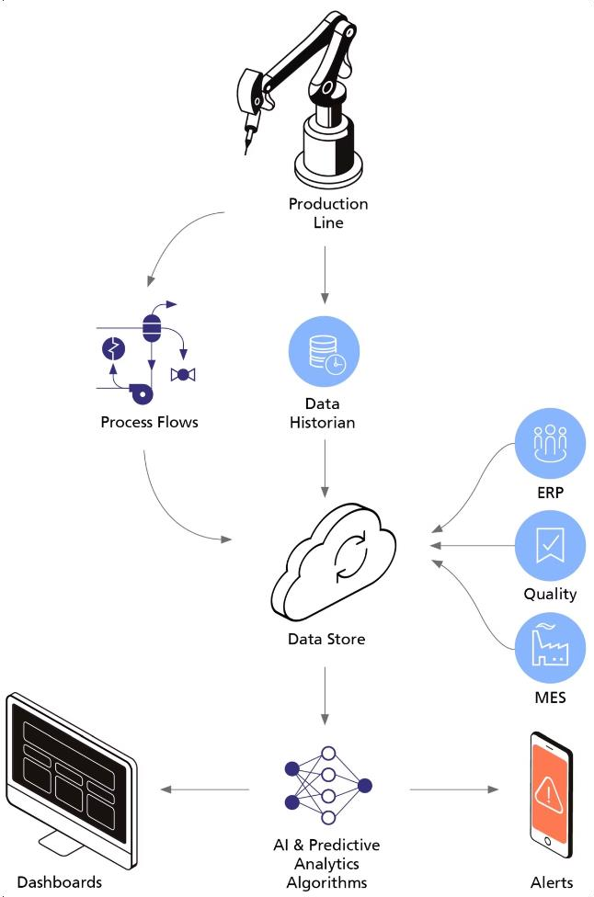
Data Collection and Sensors Sensors
1
Sensor Installation
Sensors are installed on equipment to gather performance data.
2
Real-Time Monitoring
Sensors provide continuous data on system health.
3
Data Aggregation
Collected data is aggregated for analysis.

Slide 6

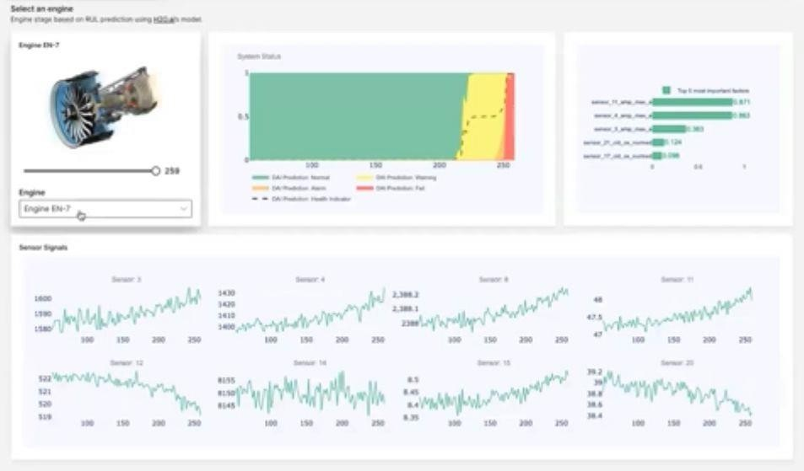
Data Analysis and Algorithms
1
Machine Learning
2
Statistical Models
Algorithms learn from historical data to predict failures.
Analyze performance metrics metrics to identify trends.
3
Anomaly Detection
Detect deviations from normal behavior to signal potential issues.
issues.

Slide 7
Predictive Maintenance Strategies
Time-Based Maintenance
Condition-Based Maintenance Maintenance
Predictive Maintenance
Scheduled maintenance based on time
time intervals.
Forecasting maintenance needs through
advanced analytics.
Maintenance triggered by sensor data data indicating that service is needed. needed.

Slide 8



Condition Monitoring and Diagnostics
Data Gathering
Sensors collect real-time data from machines.
Data Analysis
Analyzing sensor data for insights on equipment status.
Maintenance Action
Carrying out scheduled maintenance based on analysis.

Slide 9

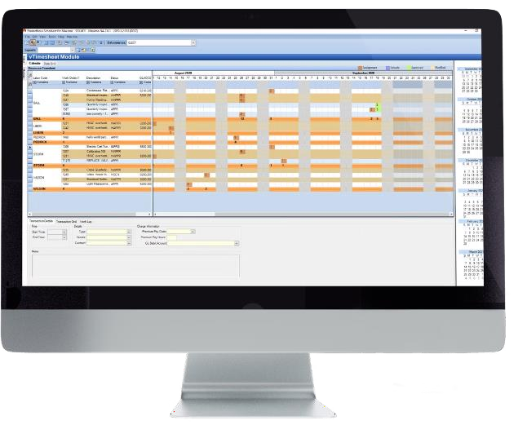
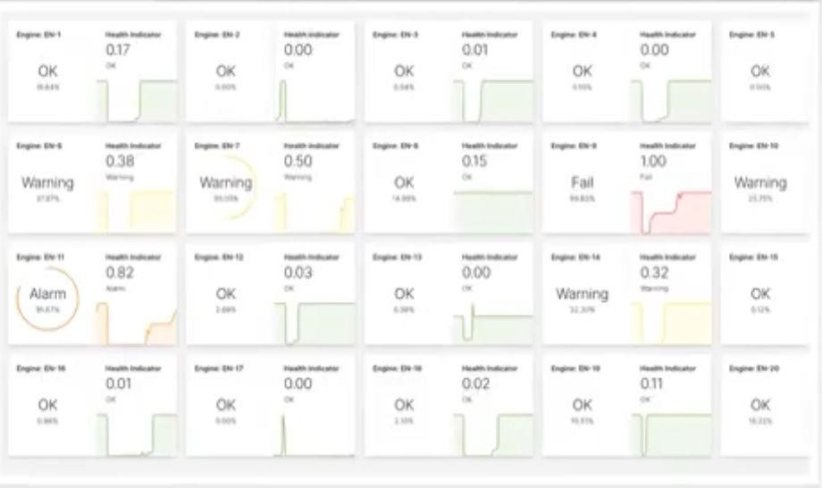
Maintenance Scheduling and and Planning
Factor | Importance | Impact on Operation
Time Management | High | Minimizes downtime
Resource Allocation | Medium | Efficient use of staff and materials
Communication | High | Improves coordination among teams

Slide 10

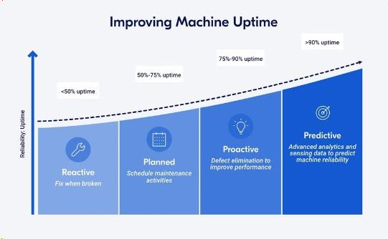

Benefits ofPredictive Maintenance
Cost Savings
Increased Uptime
Improved Safety
Reduces maintenance costs significantly over time.
Makes production processes less
vulnerable to interruptions.
Enhances worker safety with robust
machinery.

Slide 11


Challenges and Limitations
High Initial Costs
Data Management
Initial setup and technology investment can be expensive. expensive.
Handling large volumes of data data requires advanced systems. systems.
Skill Requirements
A skilled workforce is needed to manage predictive systems.

Slide 12
THANK YOU

